Slide 1
SESSION 17
Depth Estimation & 3D
Monocular Depth · MiDaS · Point Clouds

Slide 2
Today's Agenda
01
Depth Estimation Fundamentals
Why depth matters and the different approaches
02
Stereo vs. Monocular Depth
Disparity maps, depth cues, and the ill-posed problem
03
MiDaS — Robust Monocular Depth
Architecture, multi-dataset training, model zoo
04
Introduction to Point Clouds
LiDAR, RGB-D cameras, and Open3D processing
05
Practical Coding Session
MiDaS inference + point cloud exploration with Open3D
2 / 18

Slide 3
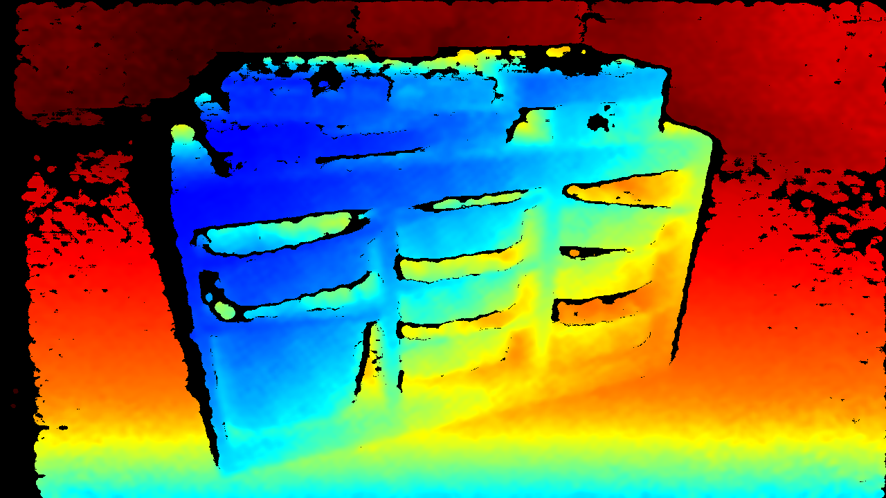
Why Does Depth Matter?
Cameras see in 2D — but the world is 3D. Depth bridges that gap.
🚗
Autonomous Driving
Detect obstacles, estimate distances in real-time
🤖
Robotics
Navigate spaces, grip objects, avoid collisions
🥽
Augmented Reality
Place virtual objects seamlessly in real scenes
🏥
Medical Imaging
Reconstruct 3D anatomy, assist surgeries
Intel RealSense D415 — Depth Map Output
Source: Intel RealSense / GitHub
3 / 18

Slide 4
Types of Depth Sensing
📷
🎯
⚡
📡
Stereo Vision
Monocular
LiDAR
RGB-D Camera
▸ Two cameras, one baseline
▸ Single camera only
▸ Laser pulses (Time-of-Flight)
▸ Color + Depth together
▸ Compute disparity between views
▸ Uses deep learning / AI
▸ Millions of 3D points/sec
▸ IR structured light or ToF
▸ Works like human binocular vision
▸ Estimates relative depth
▸ Used in self-driving cars
▸ e.g., Kinect, RealSense
▸ Needs calibrated camera pair
▸ Works with any camera
▸ Very accurate, expensive
▸ Indoor use, limited range
4 / 18

Slide 5
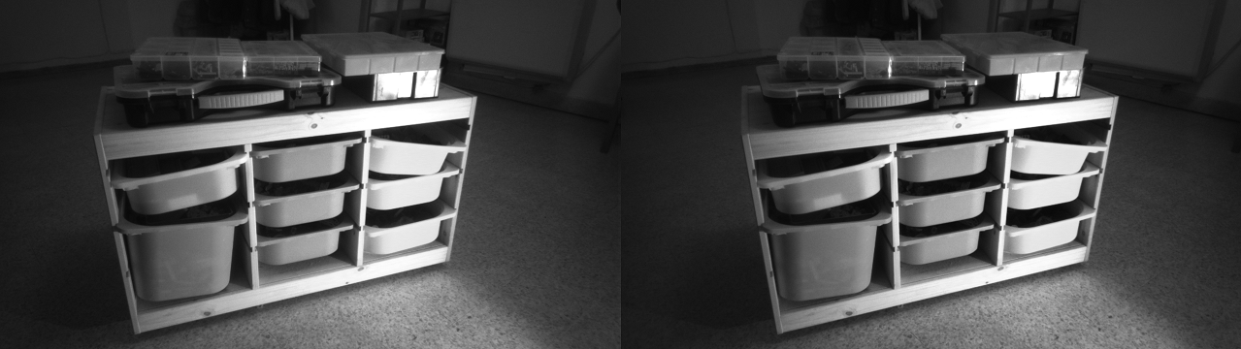
Stereo Depth Estimation
How Stereo Vision Works
1
Two cameras placed a fixed baseline apart
2
Same scene captured from slightly different angles
3
Match corresponding pixels (block matching)
Rectified stereo image pair (left + right camera)
4
Disparity d = pixel offset between left and right
Source: Intel RealSense / GitHub
5
Depth = (focal length × baseline) / disparity
Depth = (f × B) / d [ f=focal, B=baseline, d=disparity ]
5 / 18

Slide 6
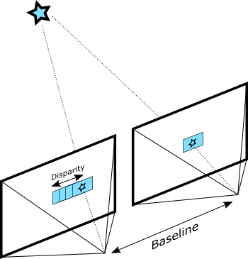
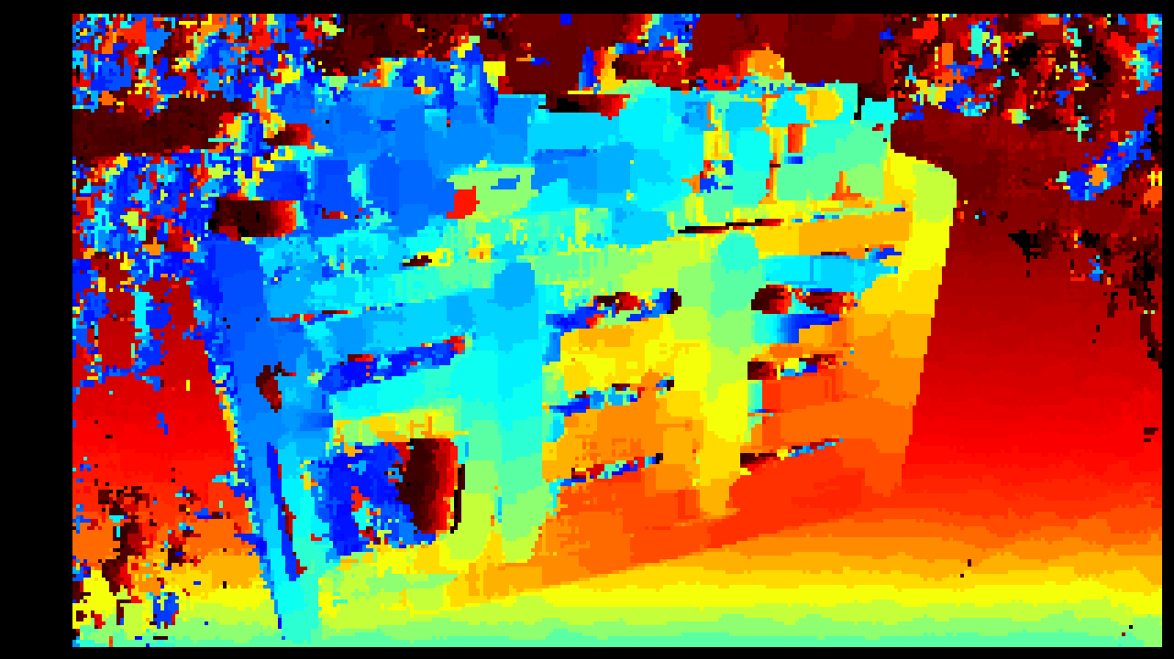
Disparity Maps: Seeing in Depth
Block matching: finding pixel correspondences
Resulting depth map — brighter = closer
Source: Intel RealSense / GitHub
Source: Intel RealSense / GitHub
💡 Key Insight: Large disparity (big shift) → object is CLOSE. Small disparity → object is FAR away.
6 / 18

Slide 7
Monocular Depth Estimation
Inferring depth from a SINGLE image — the harder problem
The Challenge
Deep Learning Solution
Monocular depth is an ILL-POSED problem.
Many different 3D scenes can produce the exact same 2D image — there is no unique solution without learned priors.
Neural networks learn depth priors from millions of labelled examples.
They recognise perspective, texture density, shading, and object size to predict plausible depth.
Visual Depth Cues Exploited by AI Models:
▸ Linear perspective — parallel lines converge at a vanishing point
▸ Texture gradient — texture density decreases with distance
▸ Relative object size — familiar objects appear smaller when far
▸ Shading & shadows — lighting cues reveal surface orientation
▸ Occlusion — near objects partially cover far objects
7 / 18

Slide 8
How Deep Learning Estimates Depth
INPUT
RGB Image
ENCODER
ResNet / ViT
Extract features
Downsample
DECODER
Upsample layers
Skip connections
Refine output
OUTPUT
Depth Map
▶
▶
▶
Encoder–Decoder Architecture (U-Net style)
Popular Model Architectures:
BEiT / Swin Transformer
ResNet + U-Net Decoder
Self-attention — captures long-range context across the image
CNN backbone — reliable and fast, great baseline
DPT (Dense Prediction Transformer)
Depth Anything v2
ViT adapted for pixel-level outputs like depth maps
Latest SOTA — self-supervised on 62 M unlabelled images
8 / 18

Slide 9
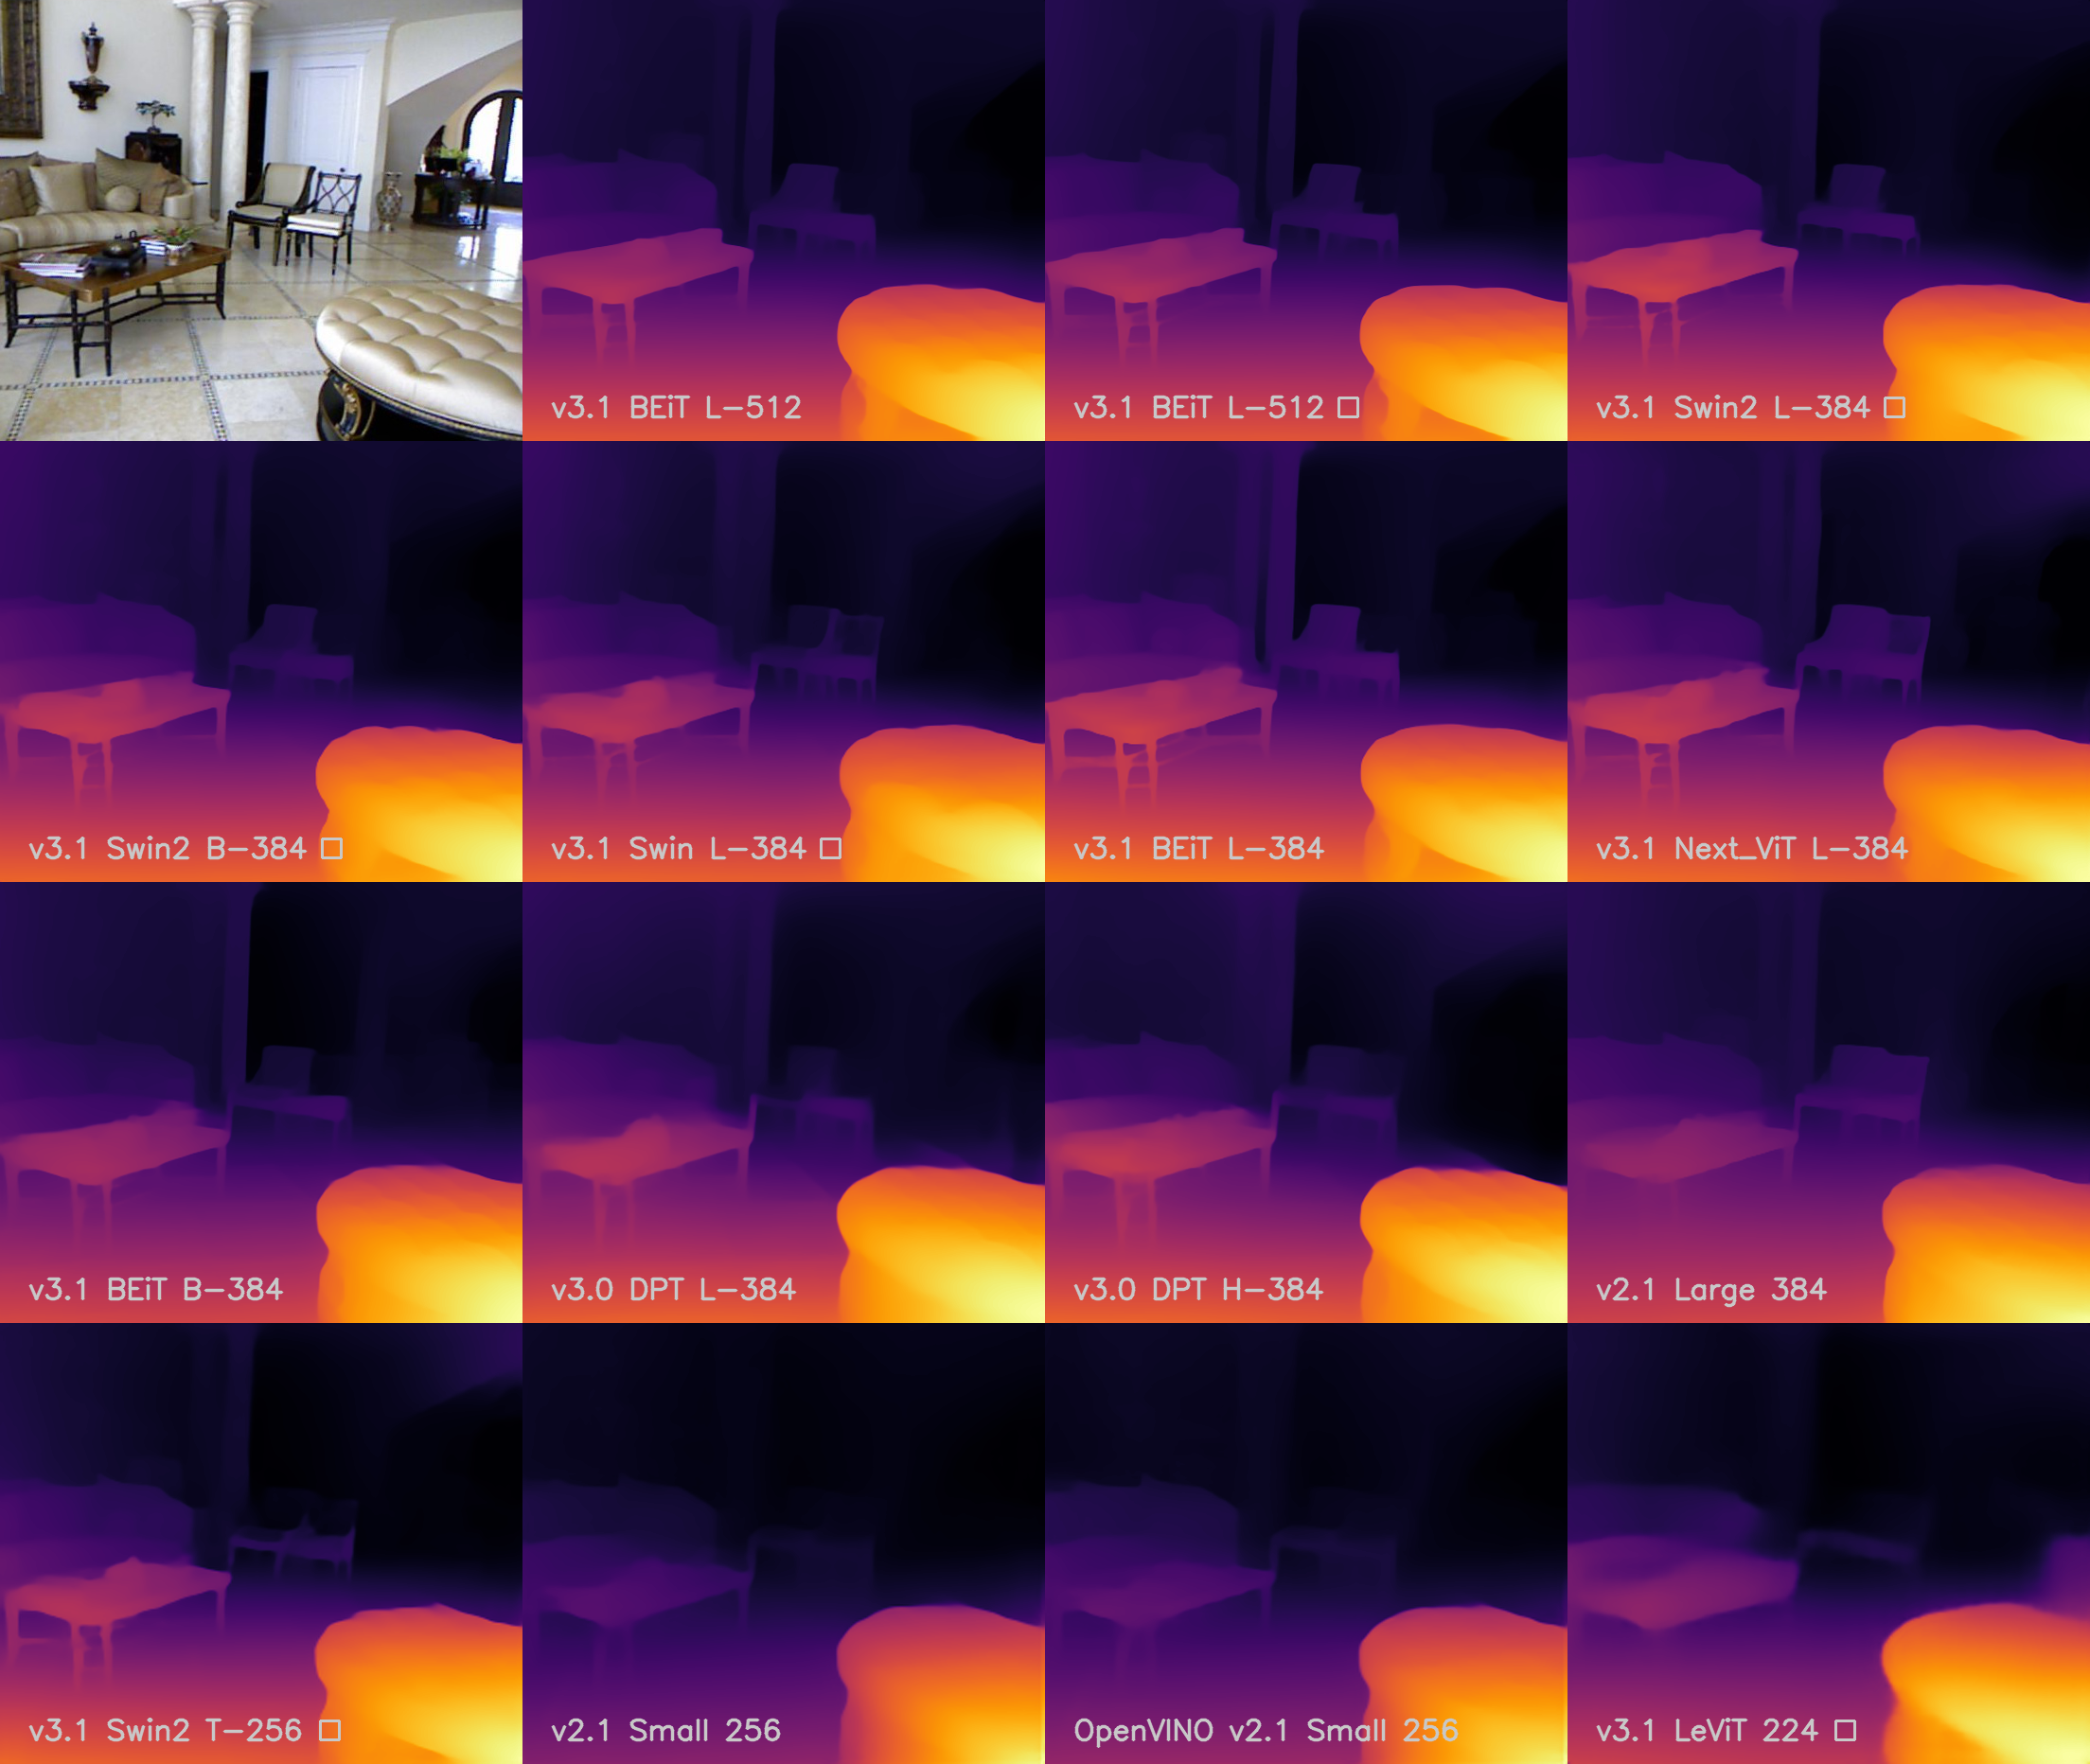
MiDaS
Mixed Data as Supervision
Robust Monocular Depth Estimation · Intel ISL · Open-Source (MIT)
12
5+
28%
Training
Datasets
Model
Variants
Better than
MiDaS v3.0
Key Capabilities:
✓ Zero-shot cross-dataset transfer (generalises well)
✓ Outputs relative inverse depth (not metric)
✓ Trained on indoor & outdoor data (12 datasets)
✓ Open-source on GitHub — MIT License
MiDaS Depth Map Comparison Across Model Versions
Source: isl-org/MiDaS · GitHub
9 / 18

Slide 10
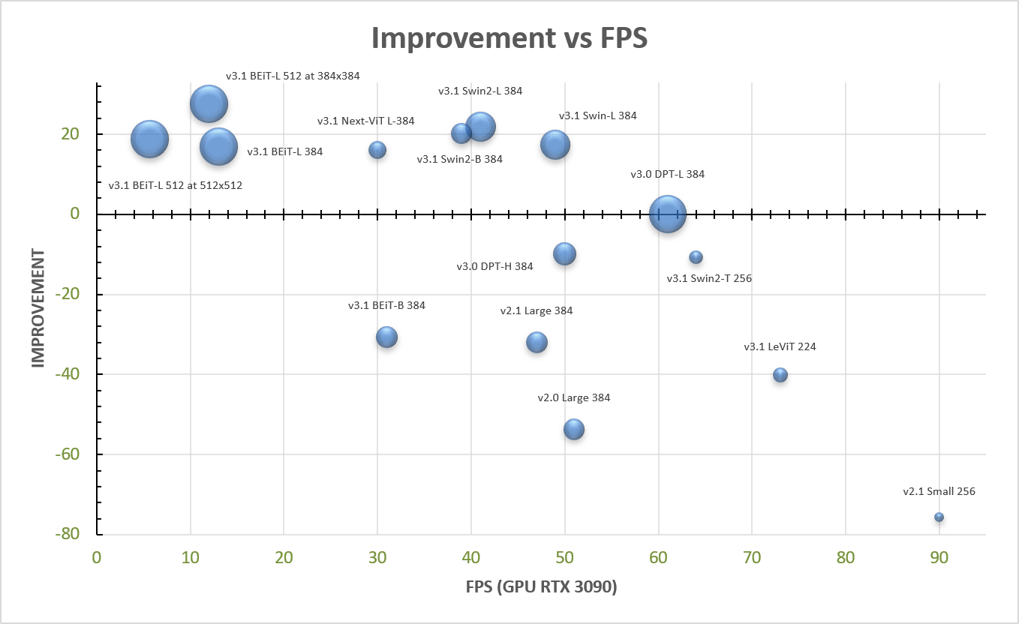
MiDaS: Speed vs. Quality Trade-off
Model Variants:
BEiTL-512
5.7 FPS
Highest accuracy
★★★★★
Swin2L-384
41 FPS
Best balance
★★★★
Swin2T-256
64 FPS
Edge devices
★★★
LeViT-224
73 FPS
Mobile / real-time
★★
Bubble size = number of parameters | Source: isl-org/MiDaS · GitHub
10 / 18

Slide 11
MiDaS in Practice
import torch, cv2
# 1. Load MiDaS model from PyTorch Hub
midas = torch.hub.load(
"intel-isl/MiDaS", "DPT_Large"
)
midas.eval()
# 2. Load the matching transforms
transforms = torch.hub.load(
"intel-isl/MiDaS", "transforms"
).dpt_transform
# 3. Load and prepare image
img = cv2.imread("photo.jpg")
img_rgb = cv2.cvtColor(img, cv2.COLOR_BGR2RGB)
batch = transforms(img_rgb)
# 4. Inference
with torch.no_grad():
depth = midas(batch)
depth = torch.nn.functional.interpolate(
depth.unsqueeze(1),
size=img.shape[:2],
mode="bicubic"
).squeeze()
depth_np = depth.numpy()
# Visualise: plt.imshow(depth_np, cmap='inferno')
Usage Notes:
Output = relative depth
Values are NOT in metres — closer objects are higher values
Match model to transform
Each model variant needs its own input transform pipeline
Colormap for visualisation
Use "inferno" or "magma" cmap for perceptually clear maps
For metric depth
Add ZoeDepth on top of MiDaS for absolute distance in m
11 / 18

Slide 12
Real-World Applications
🚗
Autonomous Driving
🤖
Robotics & Drones
🥽
Augmented Reality
· Obstacle detection & distances
· Navigate unknown spaces
· Realistic object placement
· Lane depth for safe following
· Build 3D maps (SLAM)
· Occlusion handling
· Parking assistance
· Object grasping & manipulation
· Scene-aware AR overlays
🎬
3D Reconstruction
🏥
Medical Imaging
📱
Consumer Apps
· Scene reconstruction from video
· Surgical depth awareness
· Portrait mode (bokeh)
· Heritage digitisation
· Wound measurement
· Face recognition (iPhone)
· VFX & film production
· Endoscopy 3D mapping
· AI photo enhancement
12 / 18

Slide 13
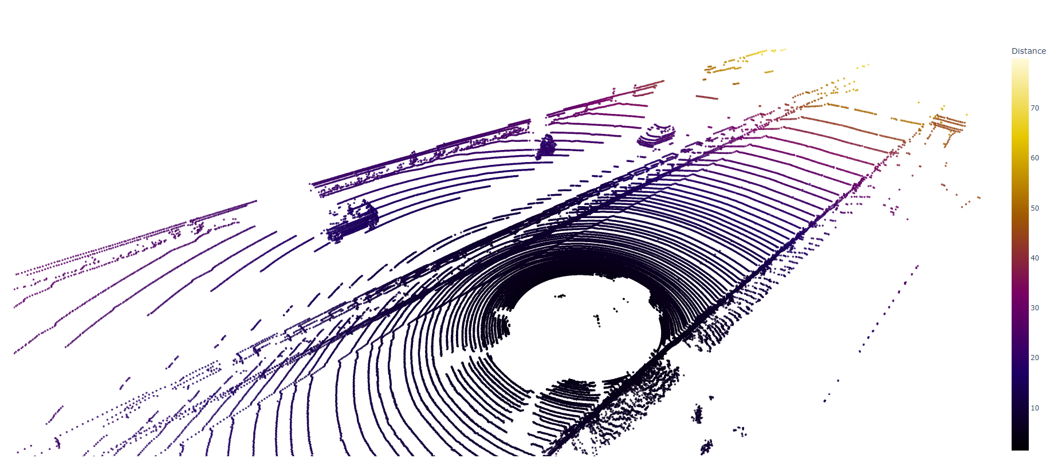
Introduction to Point Clouds
A 3D representation of the world as discrete points in space
What is a Point Cloud?
A point cloud is a collection of data points defined by (x, y, z) coordinates in 3D space, each representing a location on a scanned surface.
Each point can also store:
• Intensity / Reflectance value
• RGB colour (if camera-fused)
• Return number (LiDAR multi-return)
• Timestamp
Sources of Point Clouds:
▸ LiDAR sensors (Velodyne, Ouster)
▸ RGB-D cameras (Kinect, RealSense)
▸ Photogrammetry / Structure from Motion
▸ Depth map → 3D back-projection
KITTI Dataset — LiDAR Point Cloud (Distance → Colour)
Source: yudhisteer/Point-Clouds-3D-Perception · GitHub
13 / 18

Slide 14
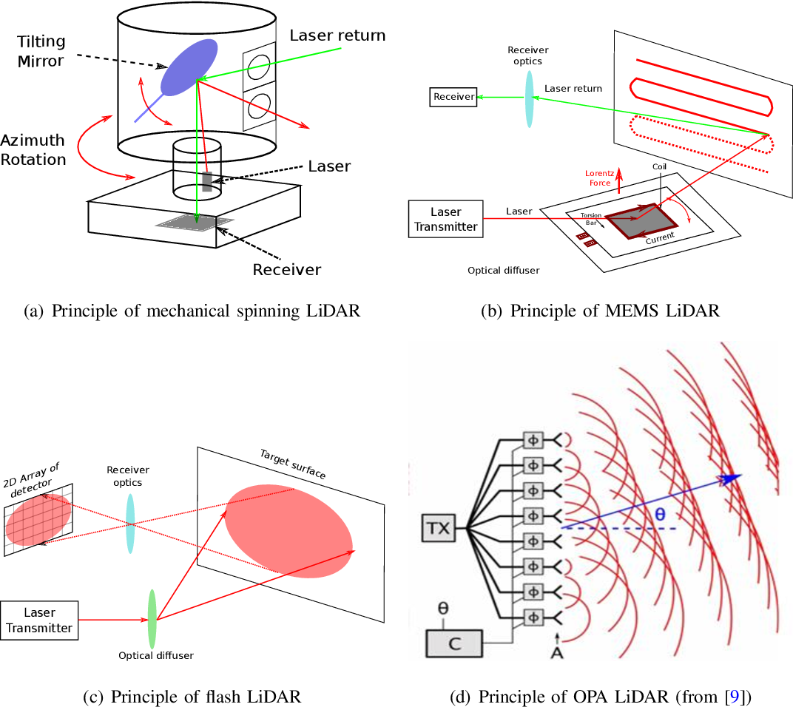
LiDAR: How It Works
Light Detection and Ranging
1
Laser pulses emitted in all directions
2
Pulses reflect off objects and return to sensor
3
Time-of-flight measured for each return
4
Distance = (Speed of light × flight time) / 2
5
Millions of points captured per second → 3D map
d = (c × t) / 2 where c = speed of light, t = time of flight
Types of LiDAR scanning mechanisms
Source: Semantic Scholar via yudhisteer/Point-Clouds-3D-Perception · GitHub
Types: Mechanical (360°) · Solid-State (MEMS / OPA) · Flash LiDAR · 2D / 3D / 4D
14 / 18

Slide 15
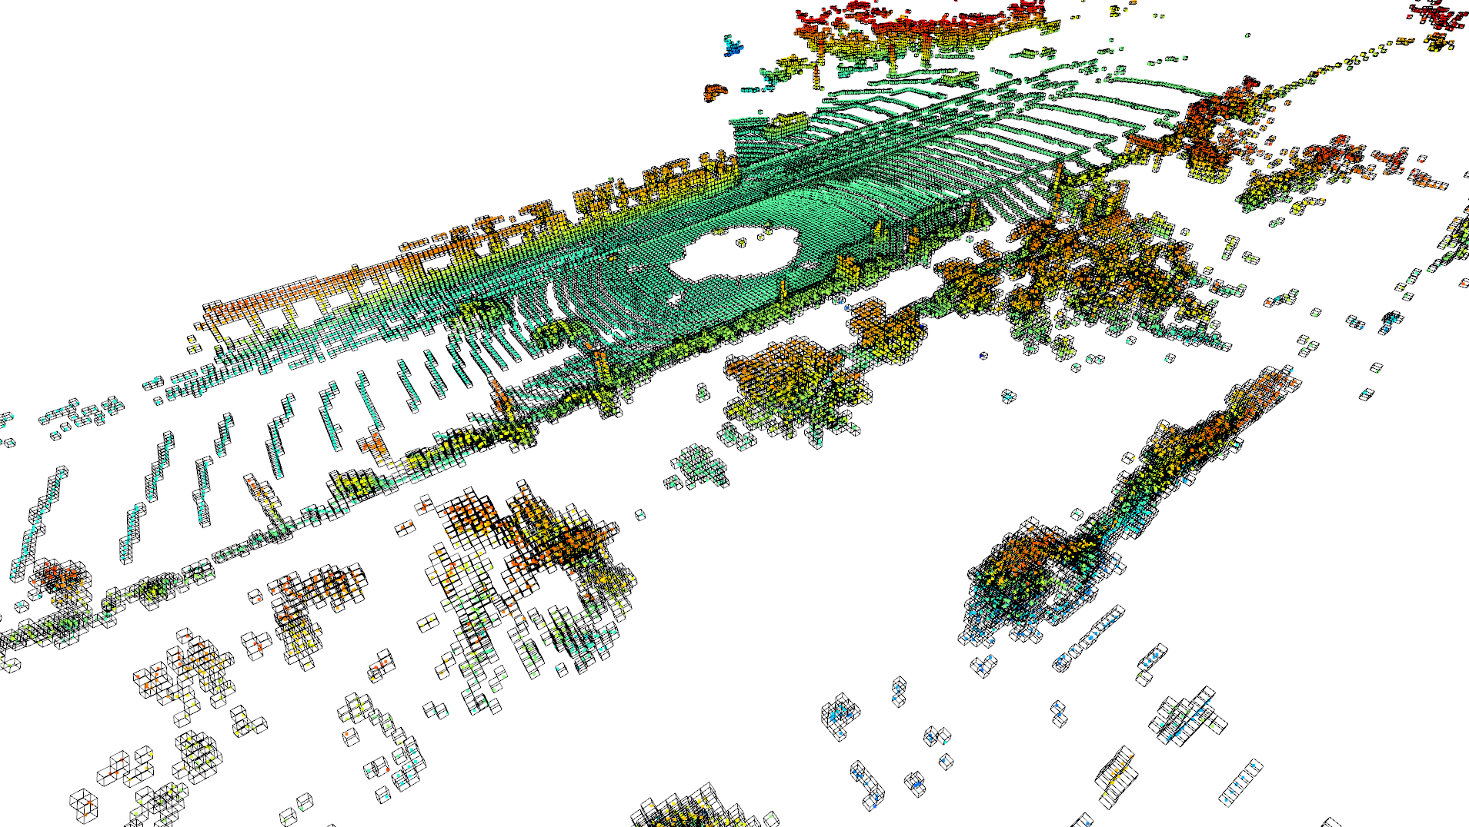
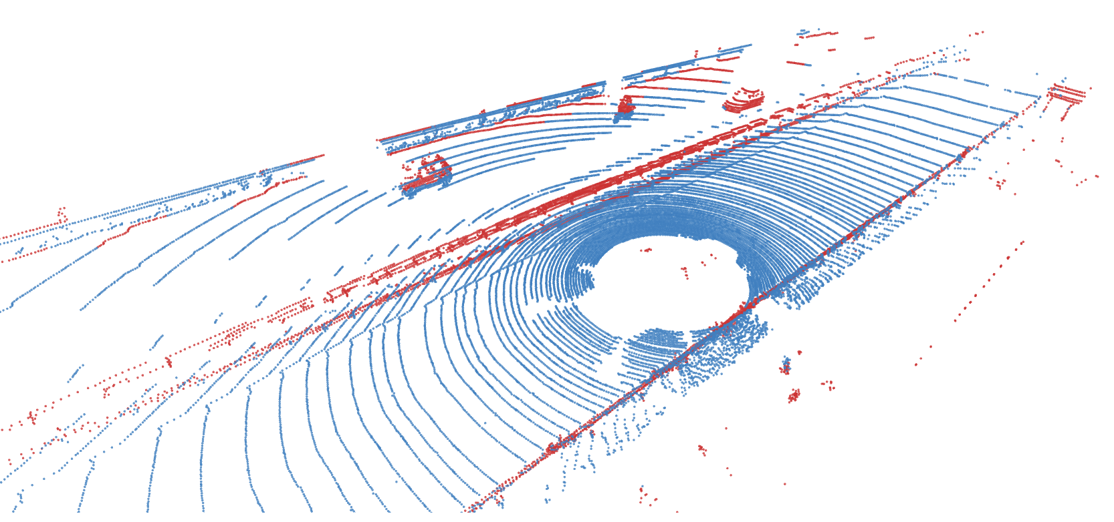
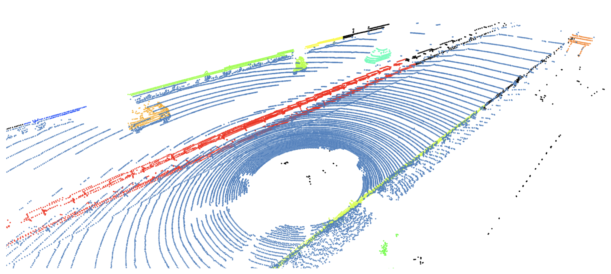
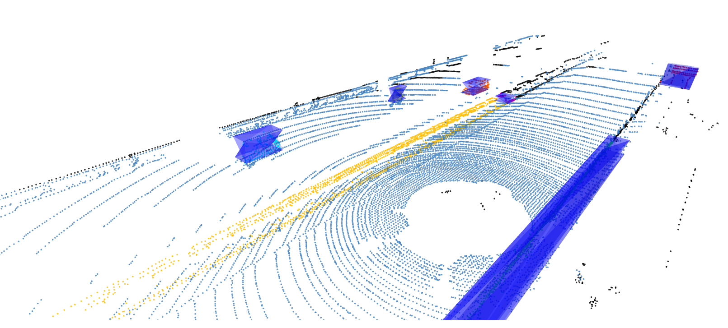
Point Cloud Processing Pipeline
Capture
▶
Visualise
▶
Downsample
▶
Segment
▶
Cluster
▶
Analyse
Voxel Downsampling
RANSAC Segmentation
Reduce number of points while preserving shape
Separate ground plane from obstacles
DBSCAN Clustering
3D Bounding Boxes (PCA)
Group nearby points into distinct objects
Fit oriented boxes around each cluster
15 / 18
Source: yudhisteer/Point-Clouds-3D-Perception-with-Open3D · GitHub

Slide 16
Connecting Depth Maps to Point Clouds
How we go from a 2D depth map → 3D point cloud
RGB
Image
MiDaS
Model
Depth
Map
Back-
Project
Point
Cloud
▶
▶
▶
▶
H×W×3
H×W×1
N×3+
Back-Projection Formula:
X = (u - cx) × depth / fx Y = (v - cy) × depth / fy Z = depth
(u, v) = pixel coords · (cx, cy) = principal point · fx, fy = focal lengths
Tools: Open3D · PyTorch3D · PCL (Point Cloud Library)
16 / 18

Slide 17
What We'll Build in Code Today
Part 1
Part 2
Part 3
MiDaS Depth Estimation
Point Cloud Exploration
Depth Map → Point Cloud
▸ Load MiDaS model from PyTorch Hub
▸ Load a KITTI .bin point cloud
▸ Take MiDaS depth output
▸ Run inference on a real photograph
▸ Visualise with Open3D
▸ Back-project using camera intrinsics
▸ Visualise with different colormaps
▸ Apply voxel downsampling
▸ Visualise 3D point cloud in Open3D
▸ Compare model variants (speed vs quality)
▸ Run RANSAC + DBSCAN clustering
17 / 18

Slide 18
Key Takeaways
📐
Depth Estimation
👁
Stereo vs Monocular
Gives machines a 3D understanding of the world from 2D camera images
Stereo is accurate but needs 2 cameras; monocular uses AI on a single image
🧠
MiDaS
☁
Point Clouds
State-of-the-art monocular depth — 12 datasets, zero-shot generalisation
Direct 3D representation — each point has (x, y, z) and optional attributes
⚡
LiDAR
🔗
Depth → 3D
Gold-standard 3D sensor — laser time-of-flight at millions of points/sec
Depth maps can be back-projected to 3D point clouds with camera intrinsics
Session 17 Complete · Next: Hands-on Coding with MiDaS & Open3D
18 / 18

